Slide 1
Web Analytics
ADVANCED SOCIAL,
TEXT AND MEDIA ANALYTICS
UNIT – II Chapter - I
DEPARTMENT OF CSBS

Slide 2
UNIT – II
Web Analytics: Web analytics tools, Clickstream analysis, A/B testing, online surveys; Web search and retrieval, Search engine optimization, Web crawling and Indexing, Ranking algorithms, Web traffic models.

Slide 3
What is Web Analytics?
Web analytics is the process of analyzing the behavior of visitors to a website. This involves tracking, reviewing and reporting data to measure web activity, including the use of a website and its components, such as webpages, images and videos.

Slide 6
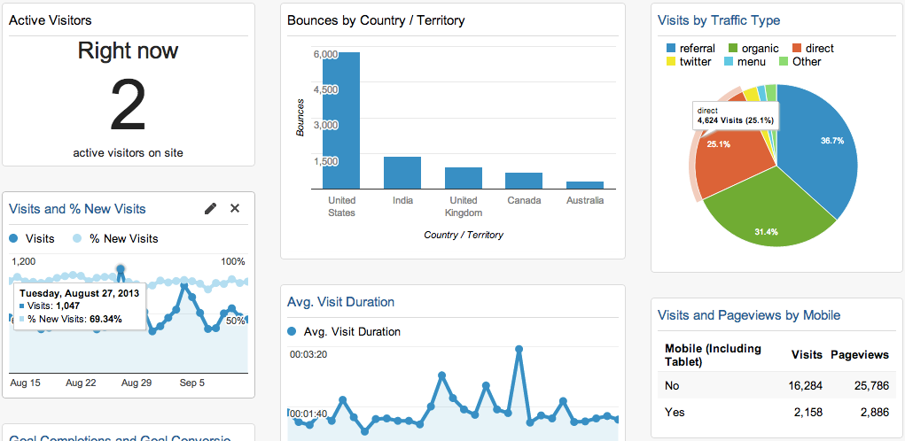

Slide 7
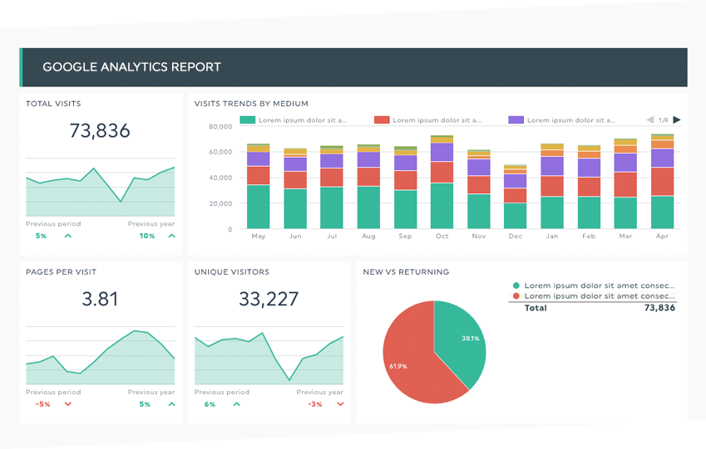

Slide 8
Web Analytics Tools
Best Free Web Analytics Tools
Open Web Analytics
Clicky
Amplitude
Hotjar
Best Paid Web Analytics Tools
Kissmetrics
SEMrush
Crazy Egg
Matomo
Adobe Analytics
Chartbeat

Slide 9
Open Web Analytics (OWA)
Open Web Analytics (OWA) tracks all the usual metrics you will expect from an analytics platform. This includes referral sites, page views, and unique visitors. However, OWA can also monitor each visitor’s click-stream, and provide heatmaps.
By using these details, OWA can provide a deep insight into how visitors are interacting with your pages.
OWA also offers ecommerce tracking.
This makes it a good choice for online store owners who are looking for a free, open-source analytics platform.

Slide 10
Key Metrics
Number of Visitors
Bounce Rate
Average Page views per Session
Session Duration
Average Time on Page
Top Traffic Source
Device Source
Interactions per Visit.
Exit Pages

Slide 11
Why You Need Web Analytics Tools
Web analytics software monitors how visitors interact with your website. This includes their behaviors and activities.
Once you have access to visitor data, you can make these goals measurable by setting Key Performance Indicators (KPIs) and benchmarks.
You can then use your web analytics platform to track visitor activity and determine if your website is meeting those standards.

Slide 12
The process of web analytics involves
Setting business goals: Defining the key metrics that will determine the success of your business and website.
Collecting data: Gathering information, statistics, and data on website visitors using analytics tools.
Processing data: Converting the raw data you have gathered into meaningful ratios, KPIs, and other information that tell a story.
Reporting data: Displaying the processed data in an easy-to-read format.
Developing an online strategy: Creating a plan to optimize the website experience to meet business goals.
Experimenting: Doing A/B tests to determine the best way to optimize website performance. You can use this information to optimize underperforming pages and further promote higher-performing ones across your website.

Slide 13
Cont ..
By installing an analytics platform on your website, you can identify what’s working and what needs improvement. This gives you the best possible chance of achieving your goals.
Google Analytics is one of the world’s most popular analytics platforms. However, it isn’t ideal for all use cases. Google’s analytics platform is strongly focused on Search Engine Optimization (SEO).
However, this solution isn’t so strong when it comes to performing other types of analysis, particularly customer behavior analysis.

Slide 14
Benefits of Web Analytics
https://www.techprevue.com/benefits-of-web-analytics/

Slide 15
Clickstream Analysis
A clickstream or click path is the sequence of pages a user visits on a website. Thus, clickstream analysis is simply the process of analyzing what pages a user visits (and in what order) on a website. This allows webmasters to better understand how their website is being used, and where they can make improvements.
Clickstream analysis factors in various analytics, such as User or Session analytics, to compare how different groups of users interact with the same website.
https://pestleanalysis.com/clickstream-analysis/#What_Is_Clickstream_Analysis

Slide 16
Applications of Clickstream Analysis
Clickstream analysis has a wide range of applications. Using just clickstream data, webmasters can identify which pieces of content may need to be improved and optimize the links between other pieces of content.

Slide 17
Clickstream data metrics
Clickstream data includes the following types of web analytics information:
Whether the individual is a unique or repeat visitor to the website;
What page the individual lands on first;
The amount of time a user spends on a page;
The features on the page the user clicks on and engages with;
When and where an item is added or removed from a cart;
Where the user goes next;
When the back button is used.

Slide 18
Cont ..
Clickstream data collected from a single session of a user interacting with a website may not be useful.
However, an organization can use aggregate data gathered from many visitors to improve its website or service.

Slide 19
Example
If a lot of visitors leave a site after landing on a page with too little information, the organization may need to enhance the page with more valuable information.
Likewise, if visitors often land on a page that is not the website's homepage, then the organization may want to redesign that page to be more inviting and informative to users.
Clickstream data does not include personal details about a user, and it is typically stored on the server that supports the website.

Slide 20
How Clickstream Analysis is used
Organizations use clickstream analytics to uncover trends and draw conclusions from different metrics about their websites. This process typically uses a web server log file to monitor user activity on a website.
Using the clickstream analysis, an organization can collect data on the number of page visits, views, and unique and repeat visitors. This data provides an idea of how the organization's website performs and it can help approximate the typical user experience.

Slide 21
Cont ..
A website owner can then adjust the site to make it more user-friendly and increase the chance that visitors will stay longer, make a purchase or otherwise interact with the website and the organization behind it.
Because an extremely large volume of data can be gathered through clickstream analysis, many e-businesses rely on big data analytics and related tools such as Hadoop to interpret the data and generate reports on specific areas of interest.
Clickstream analysis is effective when used in combining with other, more traditional market research, evaluation resources, data sources and strategies.

Slide 22
Levels of Clickstream Analysis
1. Traffic analytics
This analysis operates at the server level.
2. E-commerce analytics
This analysis uses clickstream data to determine the effectiveness of a website in terms of conversions and transactions.

Slide 23
Traffic Analytics
It collects and analyzes the following data sets:
How many pages are served to a user;
How long it takes each page to load;
How often the user hits the browser's back button;
How much data is transmitted before the user moves to a different webpage;

Slide 24
E-commerce Analytics
It is concerned with the following data points:
What pages the shopper remains on;
What the shopper puts in or takes out of a shopping cart;
What items the shopper purchases;
Whether the shopper uses a coupon code;
The shopper's preferred method of payment.

Slide 25
Benefits of clickstream data analysis
There are a number of benefits organizations can get from clickstream data and clickstream analytics. Among them are the following:
User information. The data collected can include search terms used, pages landed on, webpage features used and the addition or removal of items from a cart, all of which can lead to more actionable insights.
User routes. Organizations can use data analysis to view the different routes their online visitors or customers take to reach a page or to make a purchase.

Slide 26
Cont ..
Customer trends and insights. Collecting and analyzing the clickstreams of a large number of visitors lets an organization identify trends in the following areas:
how visitors get to the website;
what they do once there;
how long they stay on a page;
the number of page visits visitors make;
the number of unique and repeat visitors.

Slide 27
Cont ..
UX: If a majority of users quickly leave a page or website, it could be a sign that the page is poorly optimized or doesn't contain enough information of value. Clickstream data enables an organization to recognize UX shortcomings, enabling them to make necessary changes.
Digital marketing: Clickstream data can be used to determine the amount of traffic coming from ad banners and campaigns. Such data provides insight as to which advertisements are most effective and lead to customer conversion rate optimization. Clickstream analysis can also derive what times of day, month or year a marketing strategy is most effective.

Slide 28
What is A/B testing?
A/B testing also known as split testing, refers to a randomized experimentation process wherein two or more versions of a variable (web page, page element, etc.) are shown to different segments of website visitors at the same time to determine which version leaves the maximum impact and drives business metrics.

Slide 29
Cont ..
Essentially, A/B testing eliminates all the guesswork out of website optimization and enables experience optimizers to make data-backed decisions. In A/B testing, A refers to ‘control’ or the original testing variable. Whereas B refers to ‘variation’ or a new version of the original testing variable.

Slide 30
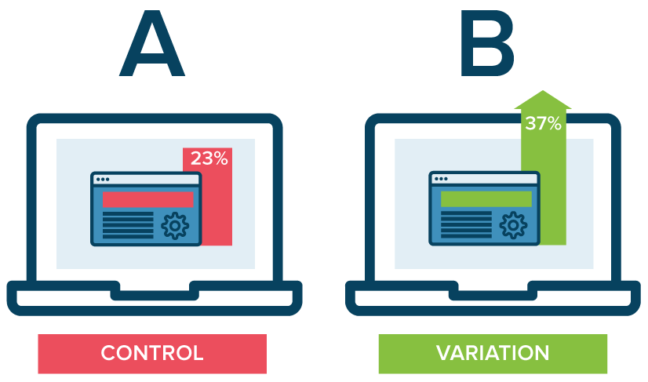

Slide 31
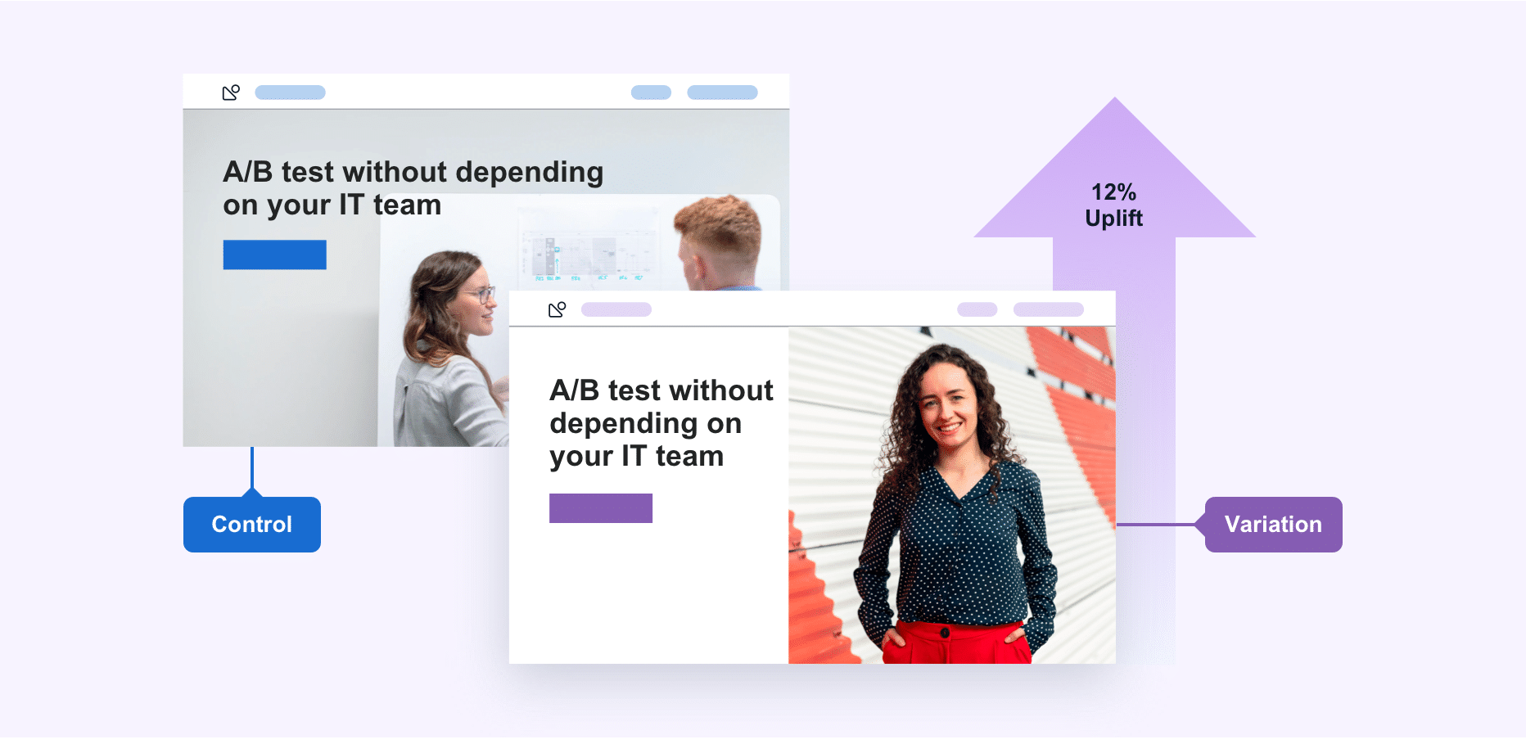
Natural Language Generation

Slide 32
Cont ..
The version that moves your business metric(s) in the positive direction is known as the ‘winner.’ Implementing the changes of this winning variation on your tested page(s) / element(s) can help optimize your website and increase business ROI.
The metrics for conversion are unique to each website. For instance, in the case of e-commerce, it may be the sale of the products.

Slide 33
Cont ..
A/B testing is one of the components of the overarching process of Conversion Rate Optimization (CRO), using which you can gather both qualitative and quantitative user insights.
You can further use this collected data to understand user behavior, engagement rate, pain points, and even satisfaction with website features, including new features, revamped page sections, etc.
If you’re not A/B testing your website, you’re surely losing out on a lot of potential business revenue.
https://vwo.com/ab-testing/

Slide 34
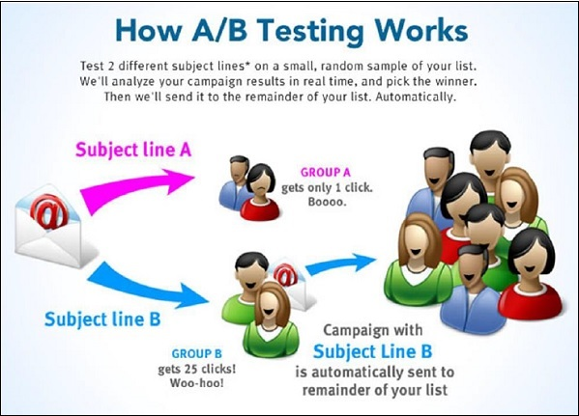

Slide 35
https://blog.hubspot.com/marketing/how-to-do-a-b-testing

Slide 36
What is an Online Survey?
Online survey or internet survey, is one of the most popular data-collection sources, where a set of survey questions is sent out to a target sample and the members of this sample can respond to the questions over the world wide web. Respondents receive online surveys via various mediums such as email, embedded over website, social media etc.

Slide 37
Cont ..
Online surveys can be used during almost all phases of a development process, including after a Web site has been launched. When used for an existing site, online surveys can be presented when visitors enter the site, when they leave, or at some point during the sessions.
Web analytics tools can be used to ask specific questions to specific groups of visitors rather than asking the same general questions to all visitors.

Slide 38
Characteristics of Online Surveys
There are six distinct characteristics that should ideally define online surveys.
Purpose of the online survey
Accurate research design
Precisely structured survey questions
Clearly defined target sample
Collection and Analysis of respondent feedback
Transparent reporting of survey responses

Slide 39
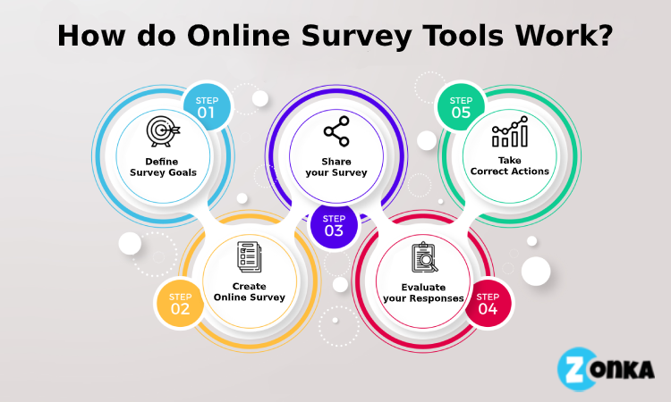

Slide 40
Online Survey Examples
An online survey can be an imperative tool to gather information from either customers or employees.
Take an example of customer satisfaction online survey:
It is very critical for a brand providing door-to-door food delivery service to be on top of customer satisfaction. They always need to evaluate customer feedback and the most effective method to collect customer satisfaction feedback is by conducting an online door-to-door survey.
After every delivery executive delivers food, the brand can either include a rating scale survey on their mobile application or the website. Customers can provide input about their experience in real-time and the brand/company can continuously work on making enhancements in their food and delivery quality.

Slide 41
Advantages of Online Surveys
Faster medium to reach the target audience
Real-time analysis
Cost-efficient
Minimum margin-of-error
Convenient to understand for respondents
Saves researchers’ time
Respondents are more truthful

Slide 42
Disadvantages of Online Surveys
Respondent Cooperation Issues
Questionable data reliability
Limited access to certain sections of a population
https://www.questionpro.com/blog/what-are-online-surveys/

Slide 43
Best Free Survey Sites
Here, we are going to discuss the best free survey sites in the world. There are various free survey sites. Some of them are as follows:
Microsoft Forms
SurveyNuts
Google Forms
SurveyPlanet
Crowdsignal
Typeform
SurveyLegend
SurveyMonkey
Wufoo
Zoho Survey
SurveyGizmo
SoGoSurvey
Survs
ProProfs Survey Maker
HubSpot Forms

